Slide 1
INVESTMENT CASE STUDY SUBMISSION
Kolkata AR:
Anik Banerjee
Ravi Shankar Hela

Slide 2

Motivation-Business Goals
Spark Fund n Finance and Investment company interested to invest in companies preferably interested in Seed, Private Equity or Venture funding.
They want to adopt “Follow the crowd” strategy which is, Invest where most investment are happening. They preferred ticket size is USD5 MN to USD15 MN. This gives us following guiding philosophy for our Analysis:
Find countries where most investments has happened.
Find Sectors where most invest are happening in those countries.
Finding funding type that fits their preferred Ticket Size.

Slide 3
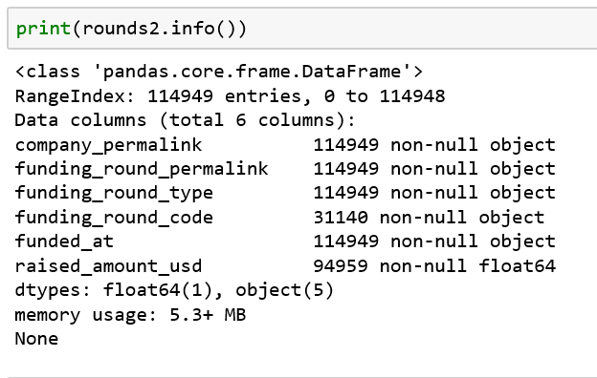
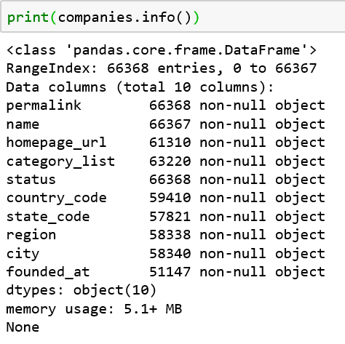
Intro to Datasets

Slide 4
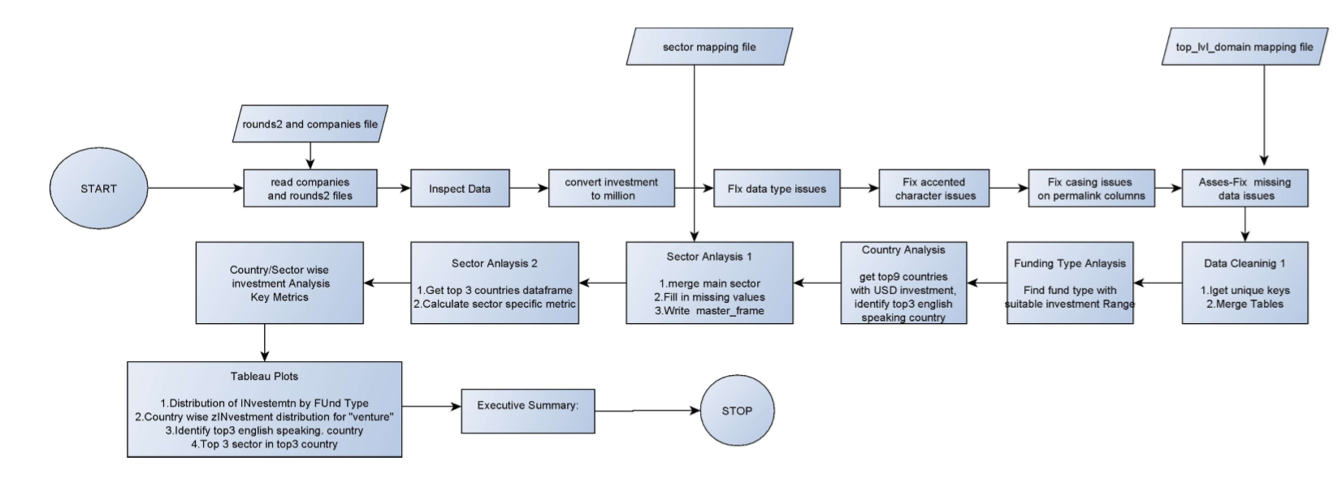
Project Workflow

Slide 5
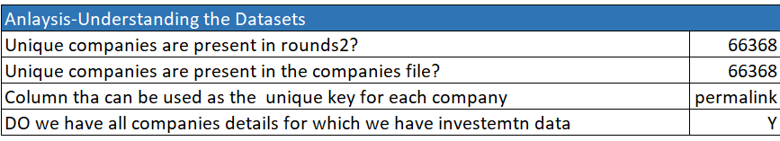
Analysis- Understanding Datasets

Slide 6
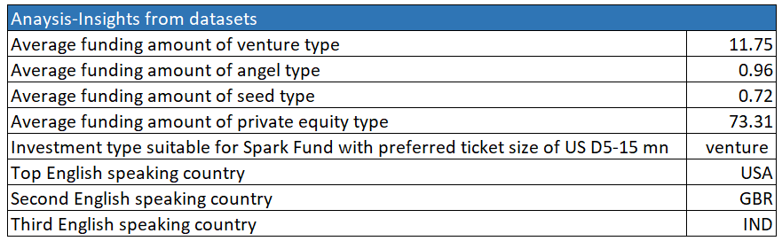
Analysis- Insights from Datasets

Slide 7
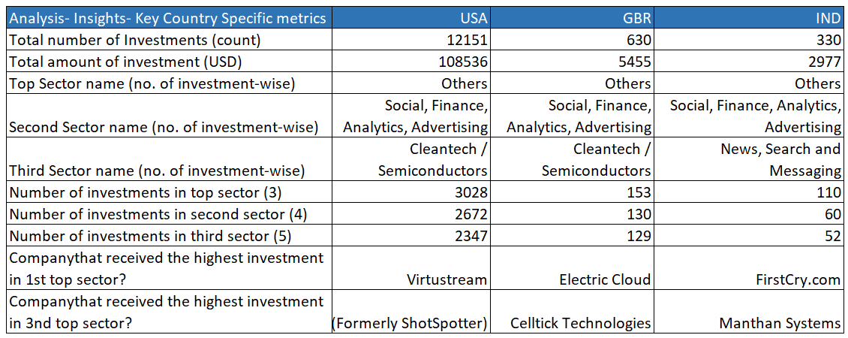
Analysis- Insights from Datasets

Slide 8
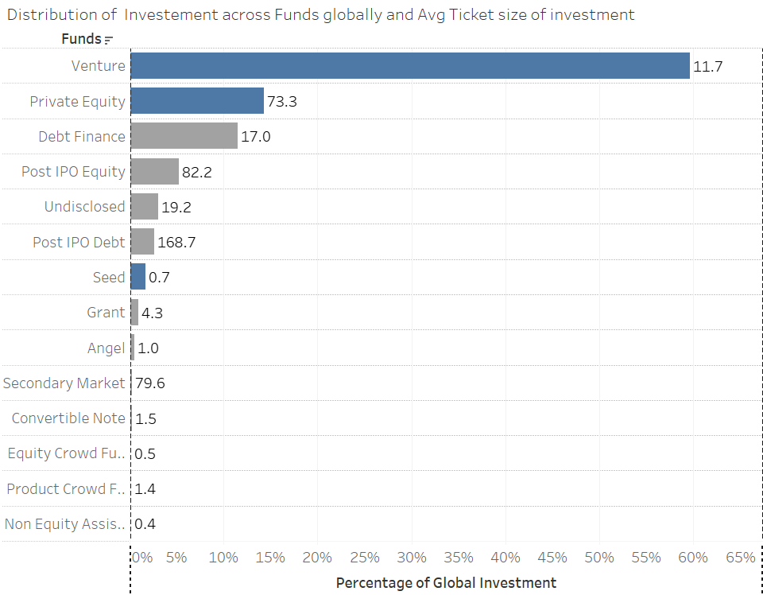
Distribution of total investments across Funds and average ticket-size of each.

Slide 9
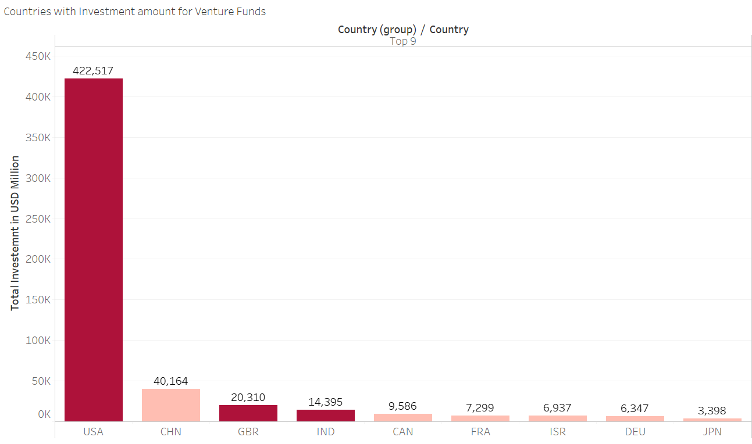
Top 9 countries where highest amount of Venture Funds are invested

Slide 10
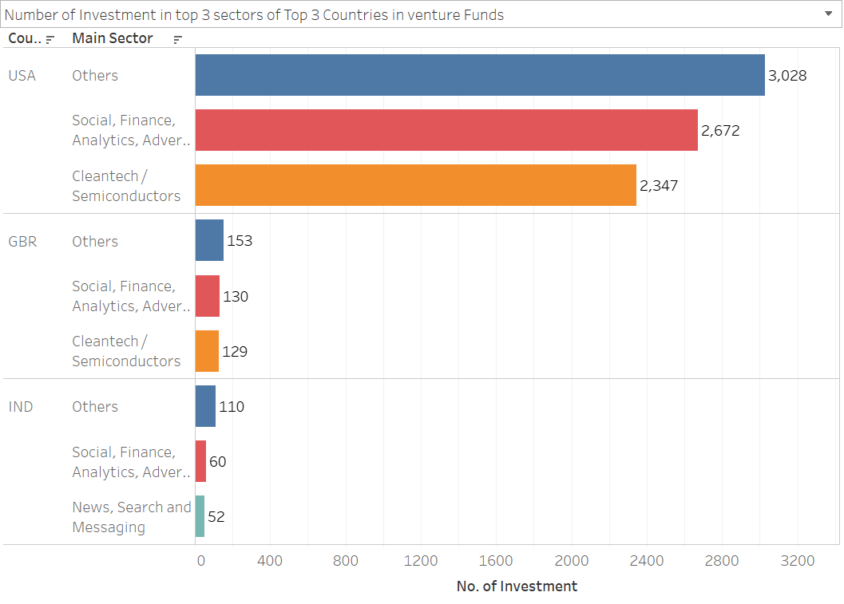
Top 3 countries and Top 3 sectors

Slide 11
Conclusion:
Spark Fund an Finance and Investment company interested to invest in companies preferably interested in Seed, Private Equity or Venture funding.
Based on their guiding strategy the Analysis recommends the following
Spark Fund should invest in Venture type Funds.
60% of the funds go tot Venture funds and the average size of Investment is USD 11.7 MN
It should invest in USA, Great Britain and India.
The top 3 English speaking countries based on total investment amount in Venture funds.
The combined Investment has been a whopping USD457, 222 Mn.
Sectors as per the most number of Investment, given funding type is Venture and range USD5-15 mn is
Social, Finance, Analytics, Advertisement, Cleantech/Semiconductors and News Search and messaging.
For key metrics on conclusion please refer to slide number 7.

